Slide 1
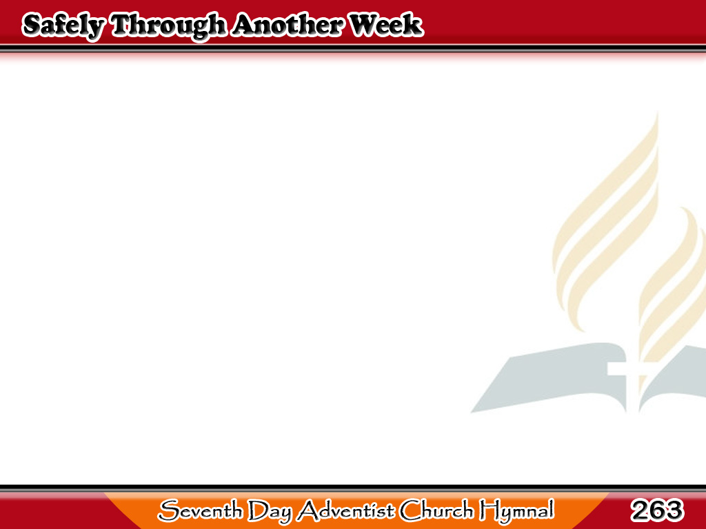
At sa Ibang Sanlinggo
Safely through another week
God has brought us on our way;
Let us now a blessing seek,
Waiting in His courts today;
1/4

Slide 2
At sa Ibang Sanlinggo
Day of all the week the best,
Emblem of eternal rest;
Day of all the week the best,
Emblem of eternal rest.
1/4

Slide 3
At sa Ibang Sanlinggo
While we seek supplies of grace
Through the dear
Redeemer’s name,
Show Thy reconciling face,
Take away our sin and shame;
2/4

Slide 4
At sa Ibang Sanlinggo
From our worldly cares set free
May we rest this day in Thee.
From our worldly cares set free
May we rest this day in Thee.
2/4

Slide 5
At sa Ibang Sanlinggo
When the morn shall bid us rise,
May we feel Thy presence near,
May Thy glory meet our eyes
When we in Thy house appear;
3/4

Slide 6
At sa Ibang Sanlinggo
Here afford us, Lord, a taste
Of our everlasting feast.
Here afford us, Lord, a taste
Of our everlasting feast.
3/4

Slide 7
At sa Ibang Sanlinggo
May the gospel’s joyful sound
Conquer sinners, comfort saints;
Make the fruits of grace abound,
Bring relief to all complaints;
4/4

Slide 8
At sa Ibang Sanlinggo
Thus may all our Sabbaths be
Till we rise to reign with Thee.
Thus may all our Sabbaths be
Till we rise to reign with Thee.
4/4

